Slide 1
The role of solar in Europe’s energy transition
RES Serbia
Walburga Hemetsberger CEO, SolarPower Europe

Slide 2
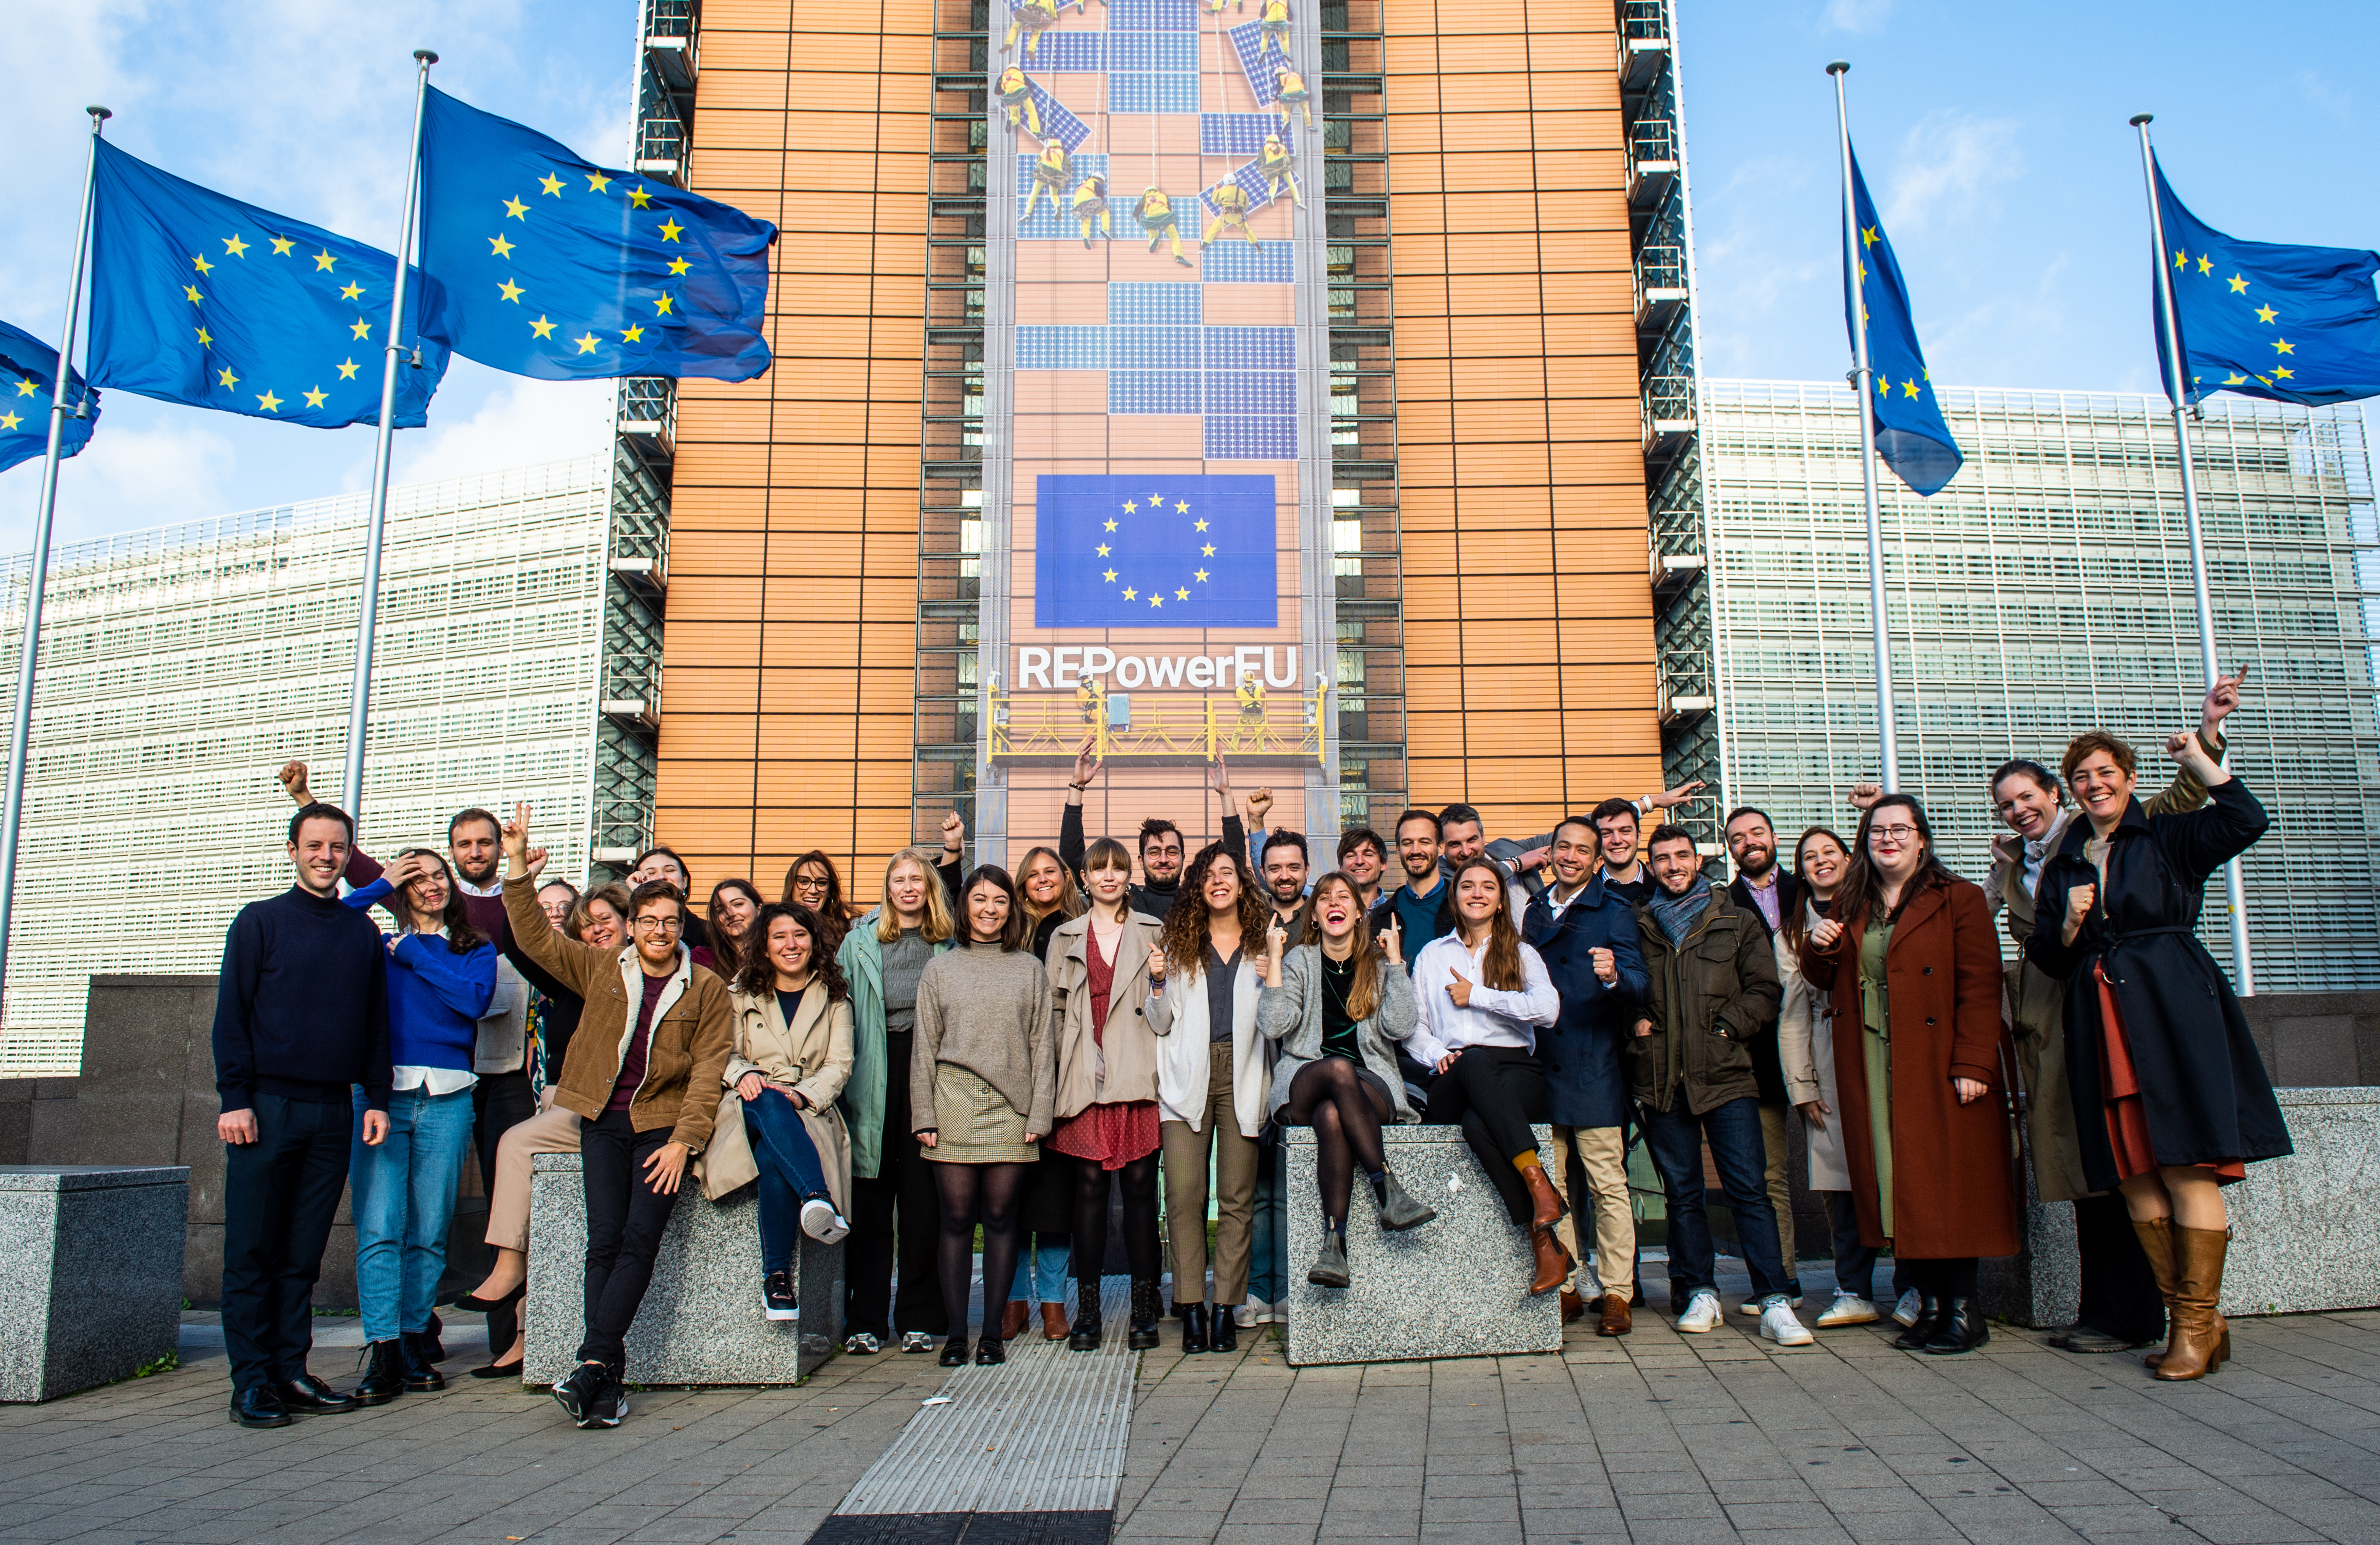

European Solar Sector Association, representing the whole solar value chain - 280+ organisations
Working closely with 30+ national associations
50+ colleagues Based in Brussels

Slide 3
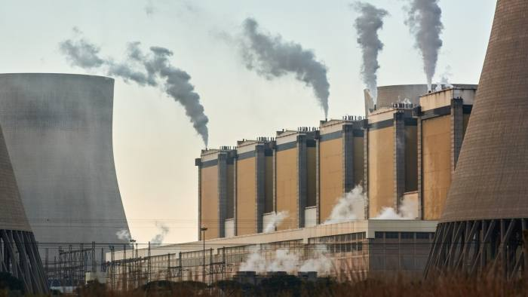
The world is at “the beginning of the end” of the fossil fuel era (IEA / FT)
The world has reached 1 TW of solar capacity
Notes:
The IEA for the first time has forecasted that demand for oil, natural gas and coal will all peak before 2030
And it is because the rollout of renewable technologies had accelerated in the past 12 months

Slide 4

“Renewables Pull” Business locations will be based more and more on where Renewables are available
Notes:
Renewables Pull“ bezeichnen: Investiert wird, wo erneuerbare Energien günstig sind

Slide 5
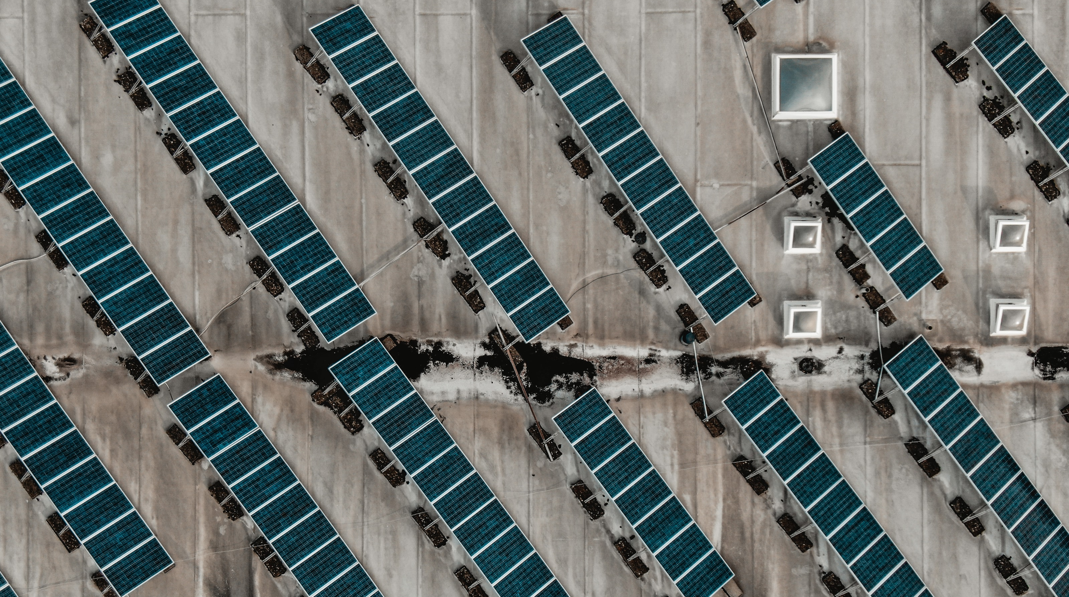
What does this mean for solar in Europe?

Slide 6


Slide 7
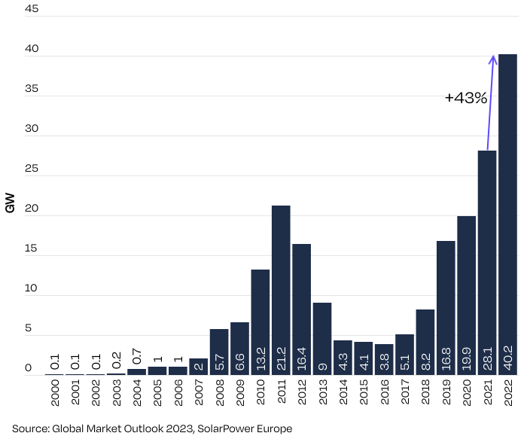
EU-27 Annual Solar PV Installed Capacity 2000-2022
Another all-time
record in 2022 for the EU-27
With 40.2 GW installed in the EU in 2022, this marks the best solar year in EU history so far, 43% higher than the 28.1 GW installed in 2021, when a decade old record was broken.
Notes:
In 2022, the 27 EU Member States saw 40.2 GW of new solar PV capacity connected to the grids, a 43% increase compared to 2021. In fact, last year had also been already a record-breaking year, when the solar market had expanded by 41% to 28.1 GW. And we assumed further quite some growth already last year.
But due to the Russian war and the energy price crisis, the role of solar in the EU has changed drastically, as both the European Commission and the Member States have identified solar technology as a green, affordable and unmatched rapid solution to their urgent needs to decrease their dependency on Russian energy imports.
While the first solar wave still looks big, and last year was the first time, we surpassed the 2011 record, soon this will be just a blip on the chart.

Slide 8
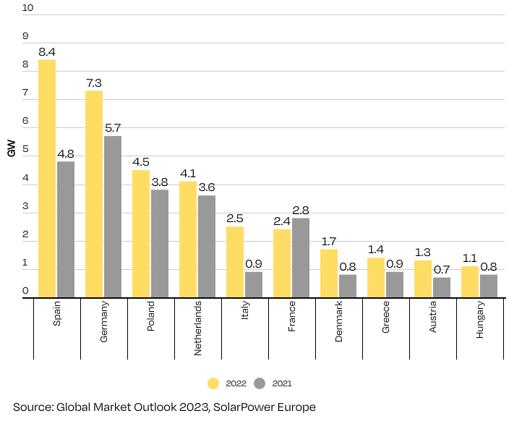
EU27 Top 10 Solar PV Markets 2022 vs 2021
Top EU solar
markets
Spain surpassed Germany in 2022 as Europe’s largest solar market. Italy is now part of the top 5 as France installs less in 2022 relative to 2021. Among the Top 10, there are only 2 newcomers (Austria & Hungary)

Slide 9
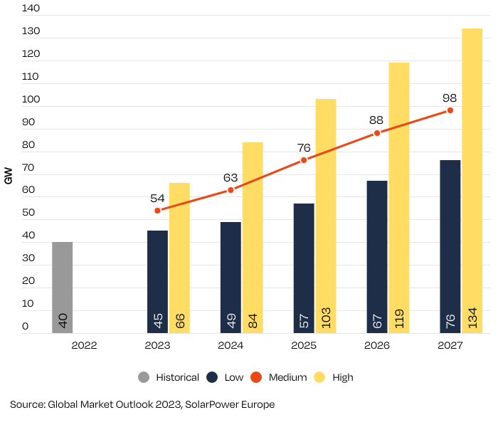
EU-27 Annual Solar PV Market Scenarios 2022-2026
EU-27 Annual Solar PV Market Scenarios 2023-2027
Further strong
growth ahead
The next 5 years until 2027 will see further strong growth, with a nearly 54 GW annual solar market already in 2023 and reaching 98 GW in 2027.
Notes:
2022 has been an impressive year for the European solar sector. The next 5 years, 2023-2027 will be characterised by further strong growth, according to our Medium Scenario (see Fig 6).
At a 29% annual growth rate, 2023 is set to be another record year for solar in the EU. The new EU ambitions set under the REPowerEU plan, along with the need to tackle the current high electricity prices, will drive the solar sector to 53.6 GW in 2023. It will be the first time that the 50 GW threshold is reached.
It will also be the year when 2 countries, Germany and Spain, are expected to exceed 10 GW annual market size for the first time. This would break the record for annual PV grid-connections in a year by a single European country. Currently, Italy holds this title from when it added 9.3 GW in 2011 with the help of uncapped feed-in tariffs.
In 2024, our Medium Scenario anticipates a 16% growth rate to 62.3 GW in the EU. The Medium Scenario growth rates will remain in the same range in the following two years – 19% in 2025 and 15% in 2026 – which will result in annual solar deployment volumes of 74.1 GW in 2025 and 85.2 GW in 2026. However, we see quite some upside potential – up to 58 GW next year and nearly 120 GW in 2026.
Some might raise their eyebrows – but don’t forget: already in the first 9 months of 2022 over 70 GW of modules were shipped from China to Europe. And yes, we have an inverter shortage, and we do have an installer shortage – and we have permitting and other challenges. And that’s why we have high- and low scenarios. But we better prepare for the high scenarios as it is in our all interest.

Slide 10
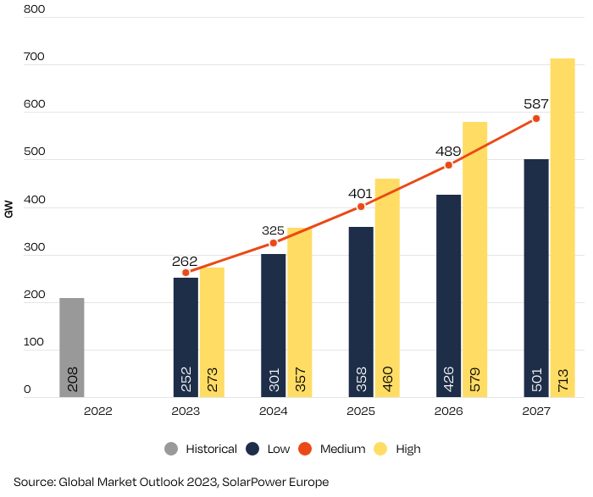
EU-27 Total Solar PV Capacity Scenarios 2023-2027
Towards 600 GW
in just 4 years
Cumulative capacity forecast 2023-2027 shows continuous, two-digit annual growth rates. The EU solar power generation fleet will more than double within four years to 587 GW in our Medium Scenario.
Notes:
Under our Medium Scenario, PV capacity installed in the EU will reach almost 600 GW by the end of 2027. This means that the EU solar power generation fleet will more than double within 4 years from the 208 GW in operation today. Interestingly, the REPowerEU interim target of 400 GW (320 GWAC) by 2025, which some considered overly ambitious at the time of publication in May 2022, is actually spot on with our Medium Scenario (399 GW by end of 2025).

Slide 11
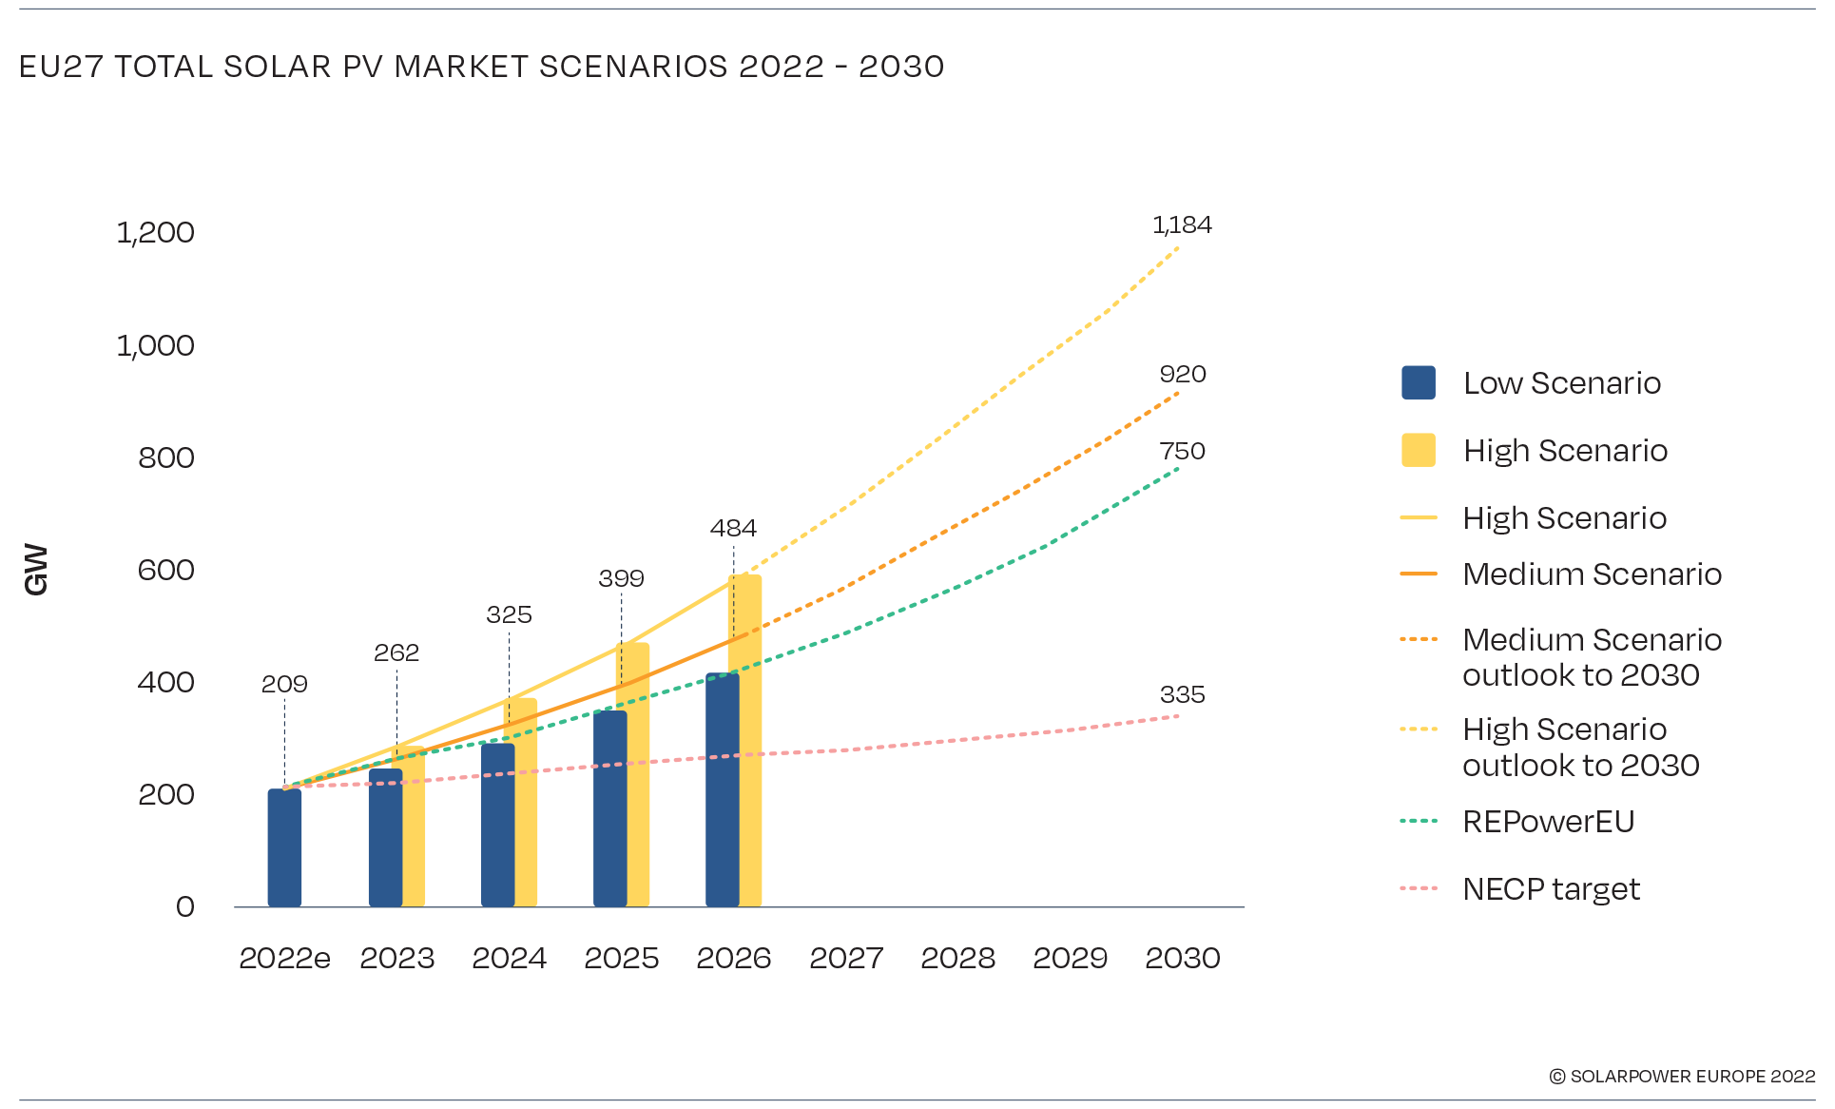
EU-27 Total Solar PV Capacity Scenarios 2023-2030
EU 2030 Medium
Scenario: 920 GW
Source: EMO 2022, SolarPower Europe
Total EU solar power fleet is expected to increase from 209 GW installed today to about 400 GW in 2025, and 920 GW in 2030. This is much higher than aggregate capacity target from NECPs (335 GW). While 2025 number is inline with EU Commission scenario (400 GW), the 2030 number is above EC 2030 target (750 GW).
Notes:
It is no surprise that our Medium Scenario 2030 outlook is almost three times higher than the 335 GW aggregate PV capacity goal from NECPs. This is another reason why Member States must revise their NECP solar targets. According to our updated forecast, the NECP aggregate target will be already met by 2025.
What is more striking is that the 920 GW total market size in our new Medium Scenario 2030 has improved so much that it now overshoots the EU Commission’s REPowerEU strategy’s 750 GW solar target by 170 GW; the previous 2030 projection was expecting 672 GW in 2030. According to our model, the improved policy and investment conditions will enable the EU to meet its REPowerEU solar target already in 2029, and surpass the target by 24% by the end of the decade.
While this is very positive news for the sector, and for the entire EU, it also indicates that the ambition could be raised even further. In fact, for the EU to remain on track to deliver on a 1.5 °C Paris Agreement scenario, ambition on renewable energy deployment must be raised. Our High Scenario 2030 outlook illustrates that if the remaining obstacles to solar development are lifted, and all Member States set appropriate levels of ambition and enabling policy frameworks, the EU could run a 1,184 GW solar power fleet by end of the decade, which is 58% higher than the REPowerEU goal. Reaching the TW-level milestone by end of the decade would pave the way for a multi-TW solar development towards 2050 which is needed for the EU to remain on its clean electrification track to deliver on its climate ambitions.

Slide 12
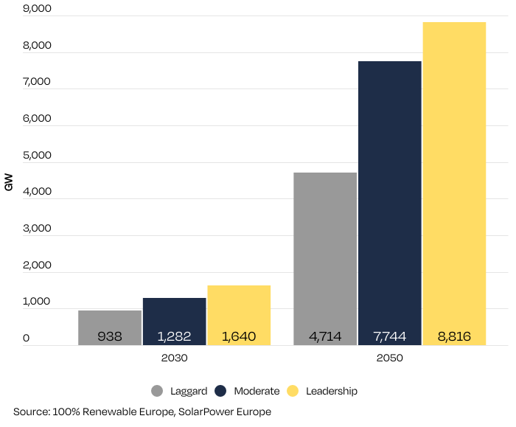
EU-27 Total Solar PV Capacity 2030 and 2050 in 100% RE scenarios
Think Big!
Thinking big is key to be realistic in solar: According to our Moderate Scenario in a 100% renewable energy system, European total solar capacity surpasses the TW threshold already in 2030 and would lead to nearly 8 TW of installed capacity by 2050.

Slide 13
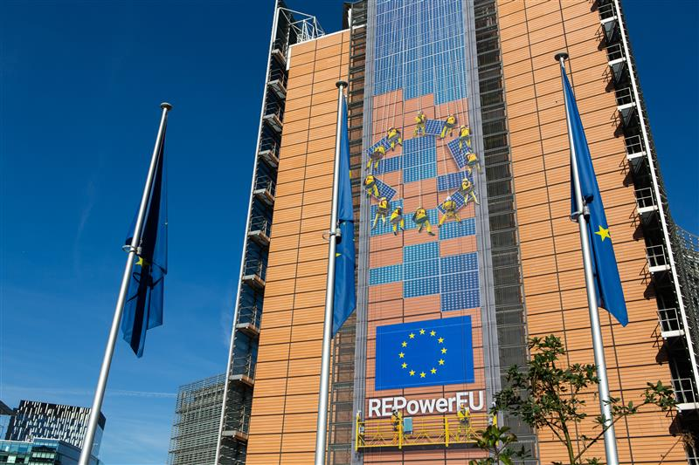
Europe has acknowledged the key role of solar as part of Europe’s Green Deal

Slide 14
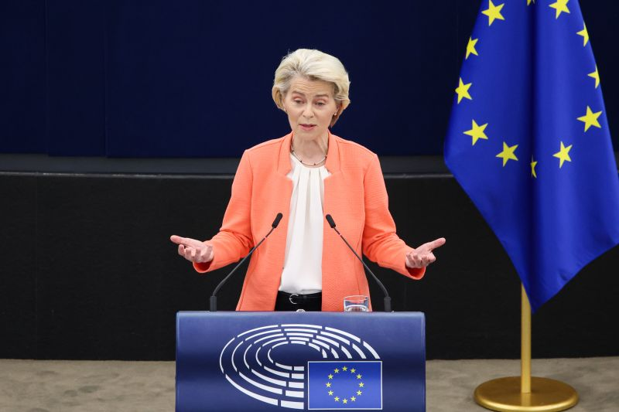
#SOEU: Putting competitiveness of European industry in the focus
Notes:
commitment to critical industry made in Europe, and that Europe will do whatever it takes to keep its competitive edge.

Slide 15
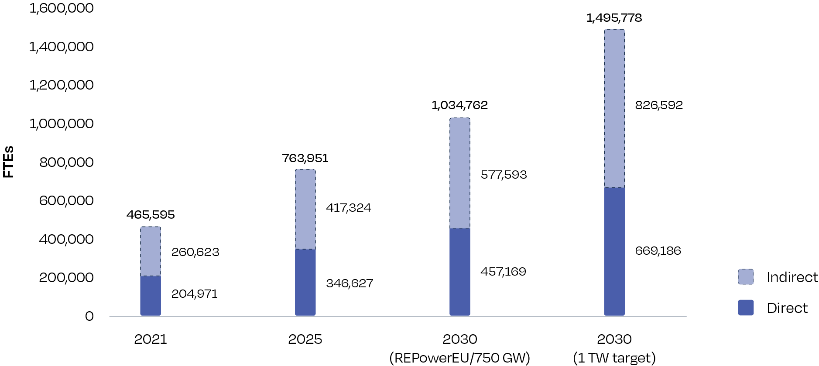
Solar Jobs Outlook to 2030
Under the REPowerEU scenario, solar jobs more than double compared to 2021, reaching 1 millions FTEs in 2030. However, with a 1 TW target solar jobs would further increase to 1.5 millions FTEs by the same year.
Notes:
Looking at the levels of solar employment in the long-term timeframe towards 2030, we analysed the size of the solar job market by that year under two scenarios. The first scenario is based on the REPowerEU strategy, which aims to reach 750 GWdc by 2030. This new target has increased EU solar ambition considerably, with significant growth taking place from the 167 GW installed at the end of last year.
Our modelling indicates that reaching the 2030 solar target will result in the creation of over 1 million direct and indirect jobs in the sector, more than doubling current employment levels.
Although the REPowerEU targets are certainly going in the right direction, the ambition still remains 26% lower than the 1 TW target that our Accelerated High Scenario is calling for. This target would enable the EU to stay aligned with a 1.5 degrees trajectory. This would not only be cost-efficient and more climate friendly, but would also lead to a large increase in employment opportunities in the solar sector. Under the 1 TW scenario, solar would employ about 1.5 million workers in 2030, which is 45% higher than in the REPowerEU scenario.

Slide 16
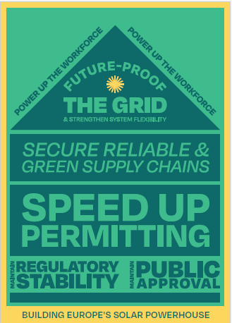
To build Europe’s power house we need to overcome 5 major bottlenecks
Notes:
Grids need to be reinforced, as part of a wider renewable electrification strategy, to become smart and adapted to new technologies. Several European markets report grid issues as a limiting factor for deployment. Grid reinforcement should go hand in hand with a framework that rewards flexibility and grid-intelligent electricity use, such as self-consumption.
To enable solar growth, spatial planning should be anticipated. Clear areas should be reserved for RES deployment, and these areas should be commensurate to long term RES targets. The permitting procedures will also need to be streamlined and smoothened up – currently, it can take up to 4 years to authorise a PV project, which is incompatible with the required pace of the transition. The RES booster package that has been put in place as part of the emergency measures is alleviating this issue by setting time limits for projects to be approved.
Staffing and skilling of the workforce will become prominent as more and more PV needs to be installed. Worker shortage is already bringing significant delays in solar deployment, especially rooftops. This is however also a great opportunity to create local long-term jobs.
Solar value chains need to become more sustainable and more European, promoting best-in-class solar products. EU manufacturing should be strengthened along the whole value chain to ensure strategic autonomy and create value in Europe.
To achieve all this, the solar industry will need a stable, long-term policy framework to ensure visibility on future deployments. Against this background, the revision of the market design shouldn’t alter the fundamental principles of electricity market functioning. The new framework should facilitate the signing of long-term contracts such as PPAs.

Slide 17
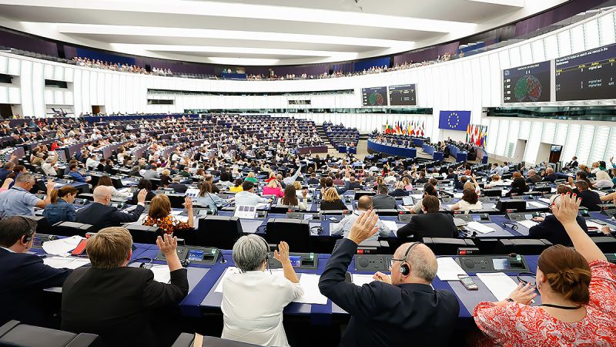
The legislative framework to get us to our 2030 ambition is
(almost) there: now it is time to implement and work on
remaining challenges

Slide 18
Thank you! Walburga Hemetsberger CEO SolarPower Europe

